Slide 1


Haystack
DeepPavlov
V.S
Notes:
So now I will share like a short summary, an “in conclusion” of my work to recap and a quick introduction to Ming En. At the start, when I was looking for potential open source QA software, I came across Haystack and DeepPavlov.

Slide 2

Haystack
DeepPavlov
V.S
Support for custom datasets
Does not take up much storage
Notes:
I chose Haystack over DeepPavlov mainly due to support for custom datasets and does not take up too much storage when setting up.

Slide 3
Extractive QA Query -> Retriever -> Reader -> Answer
Custom Pipeline with Ranker Query -> Retriever -> Ranker -> Reader -> Answer
Custom Pipeline with Multiple Retriever Query -> Retriever 1 -> Reader -> Answer Query -> Retriever 2
->
->
Notes:
One of the benefits of using Haystack that I observed throughout this internship is its customisability. From the pipelines to the components, theres always options to choose from. In my internship, I mainly test out 3 configurations. ExtractiveQA, which is Haystack’s vanilla QA framework and consist of just a retriever and reader model. Then we began looking into custom pipelines with the addition of a Ranker component. Lastly, we venture into custom pipelines with multiple retrievers.

Slide 4
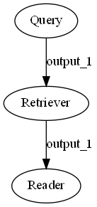
1. Extractive QA
Retriever - BM25 - Dense Passage Retriever (DPR) - TF-ID - Embedding
Reader - TransformersReader - FarmReader
Notes:
While looking into the default QA pipeline, I tested out the options available for the retriever and reader component.

Slide 5
1. Extractive QA
Retriever - BM25 - Dense Passage Retriever (DPR) - TF-ID - Embedding
Reader - TransformersReader - FarmReader
Notes:
Using 10 questions set by me, the best results came from the following configuration of BM25 retriever and TransformersReader.

Slide 6
1. Extractive QA
Reader Model - roberta-base-squad2 - bert-large-uncased-whole-word-masking-squad2 - bert-large-uncased-whole-word-masking-finetuned-squad - distilbert-base-uncased-distilled-squad - distilbert-base-cased-distilled-squad - albert_xxlargev1_squad2_512
Notes:
The model used for the Reader component was chosen after a test among the top 6 most downloaded QA models from huggingface. The Roberta variant performed the best on my laptop and is also coined an “all-rounder” model by the development team in Haystack. However, that model is not as accurate as the Albert model. However, due to the large computational power required, I am unable to run the model.

Slide 7
1. Extractive QA
“Better” Retriever via DPR? - FAISS + DPR
Notes:
While the previous configuration works, Haystack advertised better Retriever results using DPR and FAISS document store. However, my testing actually shows worse result than using the previous configuration.

Slide 8
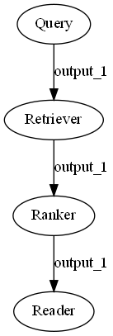
2. Custom Pipeline with Ranker
Reader Model - SentenceTransformersRanker - FARMRanker
Notes:
Next, we began customising our pipeline with the addition of a Ranker component. From my testing, both Ranker types does not show any noticeable differences in their answers.

Slide 9
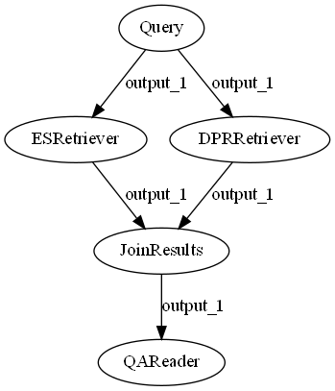
3. Custom Pipeline with Multiple Retriever
Join_mode - Concatenate - Merge
Notes:
Lastly, I continued looking into custom pipelines and found that Haystack can actually use both retrievers instead of choosing one. In the JoinResults component, it is possible to choose how the scores of the retrieved documents are sorted and aggregated, by changing the setting of the JoinMode argument. For this as well, testing shows no change in answer when using either settings. Furthermore, the answers given by this configuration is not as good as the default Extractive QA pipeline, hence I went to test other configurations.

Slide 10
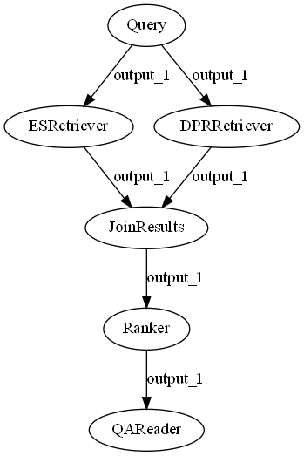
3. Custom Pipeline with Multiple Retriever
Initial
1
Notes:
The first configuration I tested is to add a Ranker component after joining results from both retrievers. However, the result is still not as good and thus I tried adding the Ranker to after the BM25 retriever instead.

Slide 11
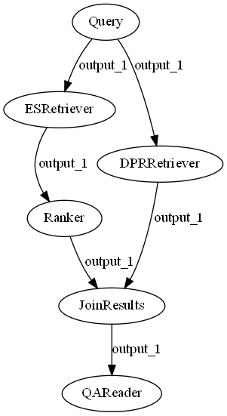
3. Custom Pipeline with Multiple Retriever
Initial
1
2
Notes:
The second configuration was able to achieve almost the same result as the default Extractive QA if you remember what I shared before this summary.

Slide 12
Possible Future Work
Test Albert with better hardware
Long-Form QA (with FARMReader?)
Training Retriever and Reader model
Notes:
I would like to end off with some possible future work for Ming En that would be taking over this QA project. Testing Albert with better hardware. As mentioned earlier, the Albert QA model might be able to output better answers and as a proof of concept, I tested it on Google Colab with their Telsa K80 GPU, which is much stronger than my laptop 1060. The results from TransformersReader is similar but the kicker comes when paired with FARMReader. With FARMReader, it was able to fully answer 1 of the questions that the best previously can only answer partially. I was stucked on Q4 due to a out-of-memory error so I think that there is potential in trying out Albert with better hardware. Long-form QA is a point I mentioned in my internship presentation where the QA system would be able to output longer answers like the one you see just now. From testing, looks like FARMReader is capable of long answers but would need tweaking like using a Ranker alongside to make it usable. Lastly, I have no touched on training but could be something to invest into down the workflow when the team decide to commit to using Hatysatck.

